Slide 1


Quality ICT (Q-ICT)
Christopher Sulistiyo (4850025)

Slide 2

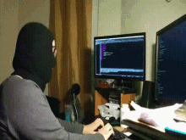



Who are we?
Cybersecurity consultant operating in North Holland
± 20 employees excluding interns
Horizontal/flat organizational structure
Offices: Emmen (main) and Groningen
Notes:
Groningen is a sales office, built as a branch so that clients from that area can reach easily

Slide 3
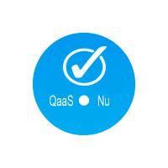
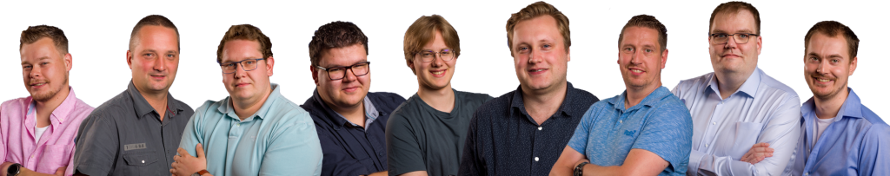


MKBiT => Parent Company
Q-ICT & QaaS => Child Companies
MKBiT: IT solutions
Q-ICT: cybersecurity oriented
QaaS: tailor-made software applications

Slide 4

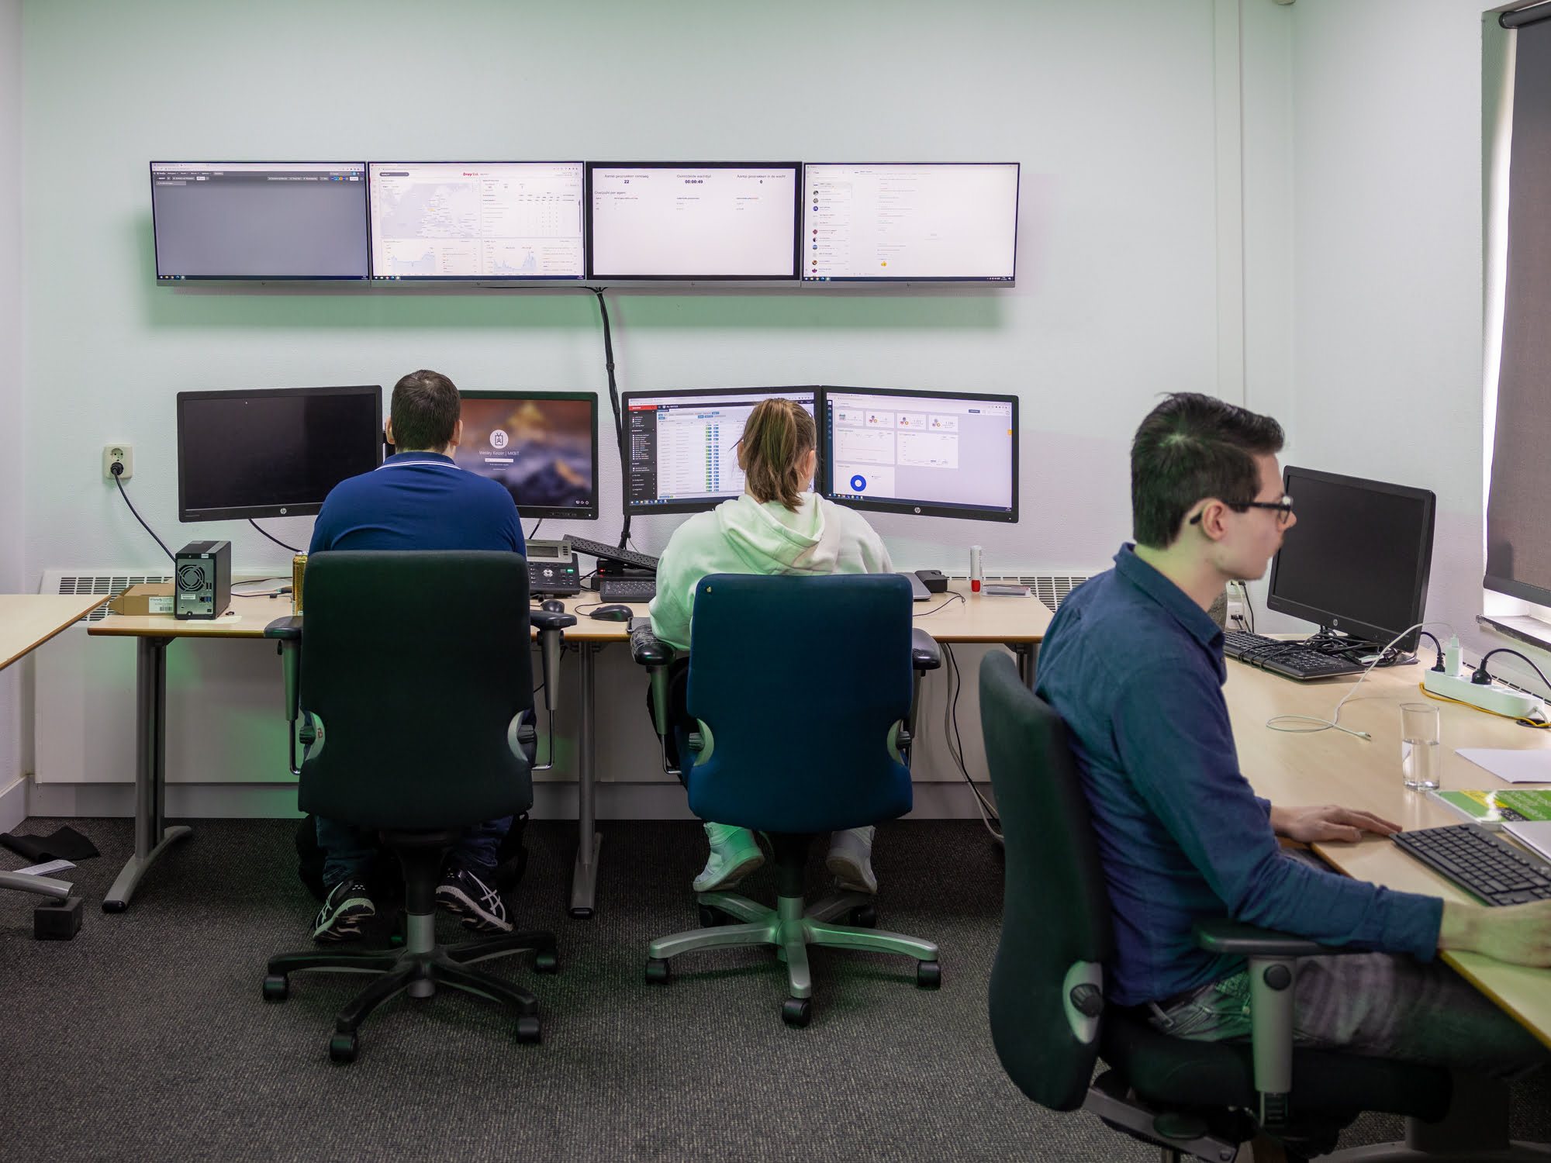
Services
Q-ICT
Security/system scans
Microsoft 365 products
Software development
MKBiT
Antivirus & anti-spam software
Cloud services (online back-ups)
Active monitoring
Database migration
Patch management
Notes:
Reseller subscription

Slide 5





Partnerships
Notes:
SentinelOne: American cybersecurity company, provides antivirus armed with advanced threat intelligence with the help of AI
Bodyguard: in Amsterdam, scanning download files and attachments from emails for any malware
N-Able is a RMM (Remote Monitoring and Management) for remotely monitor, manage, and support client’s computers by N-Central
Ubiquity: providing WAP

Slide 6




Notes:
DrayTek: routers
Acronis
Computicate

Slide 7
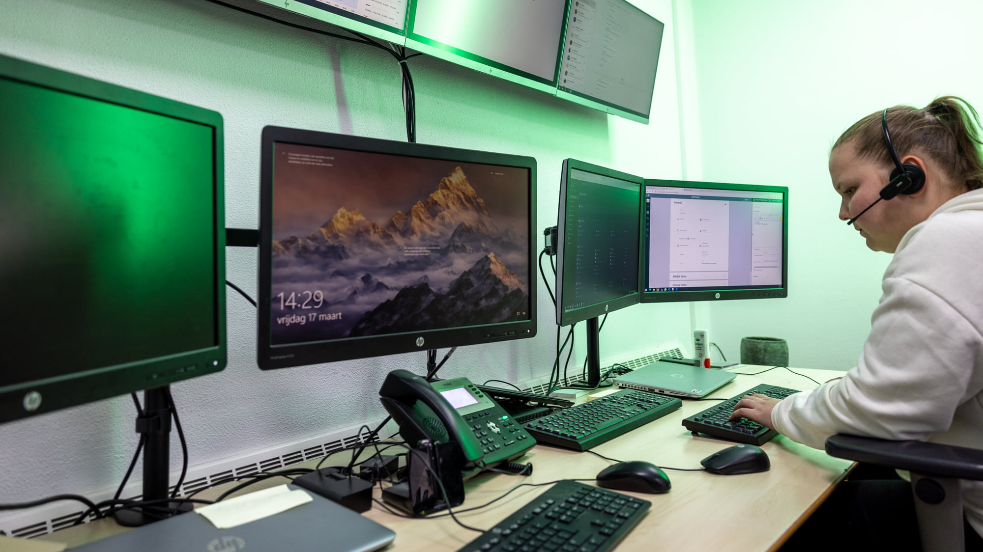
Unofficial Partnerships
MemoICT
Peat Digital
Ondernemend Emmen
Indiv Solutions
Webba
Notes:
MemoICT: web application development for e-commerce
Peat Digital: digital marketing
IndivSolutions
All those companies share their office in the same building with Q-ICT

Slide 8
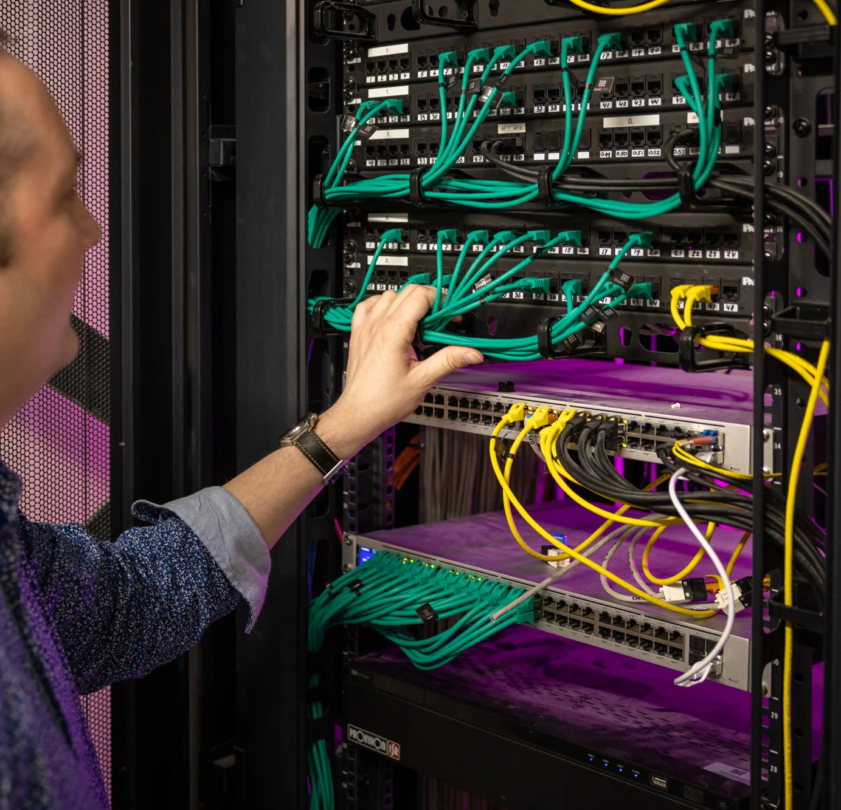
Tools
Computicate (Acronis)
TOMTelecom (provider)
SnelStart
PerfectView
Pax8 (reselling platform (Microsoft subs, word, Microsoft stack))

Slide 9
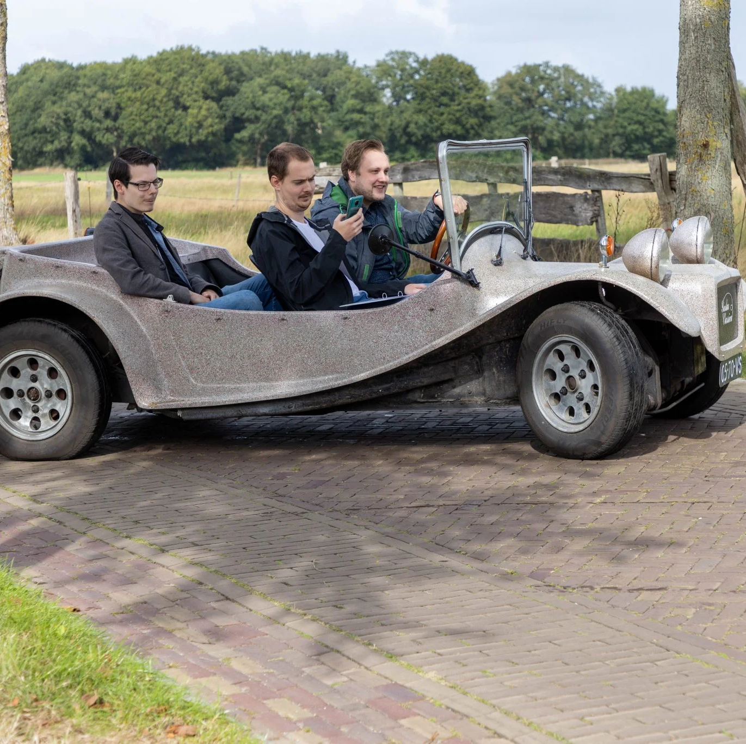
The Departments

Slide 10
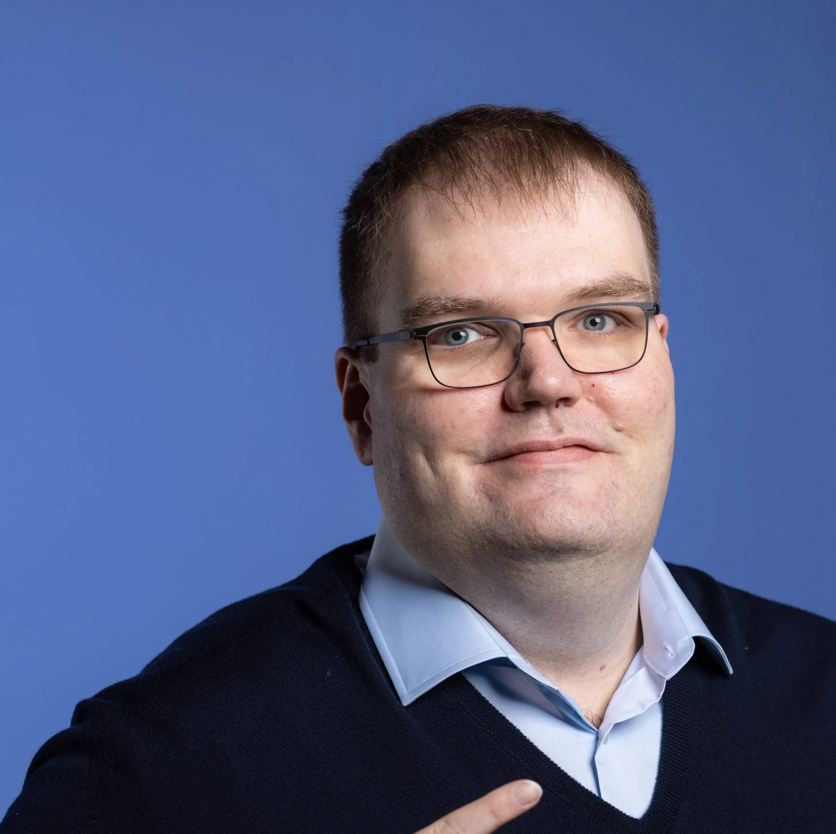
The Director
Mark Kolk (senior cybersecurity specialist and the director)
Also handles HR and partly financial problems
Founded the company in 2004
Height: 2.18m
Notes:
The company follows a horizontal/ flat organizational structure, fewer levels of middle managements. Employees have direct access to the director

Slide 11
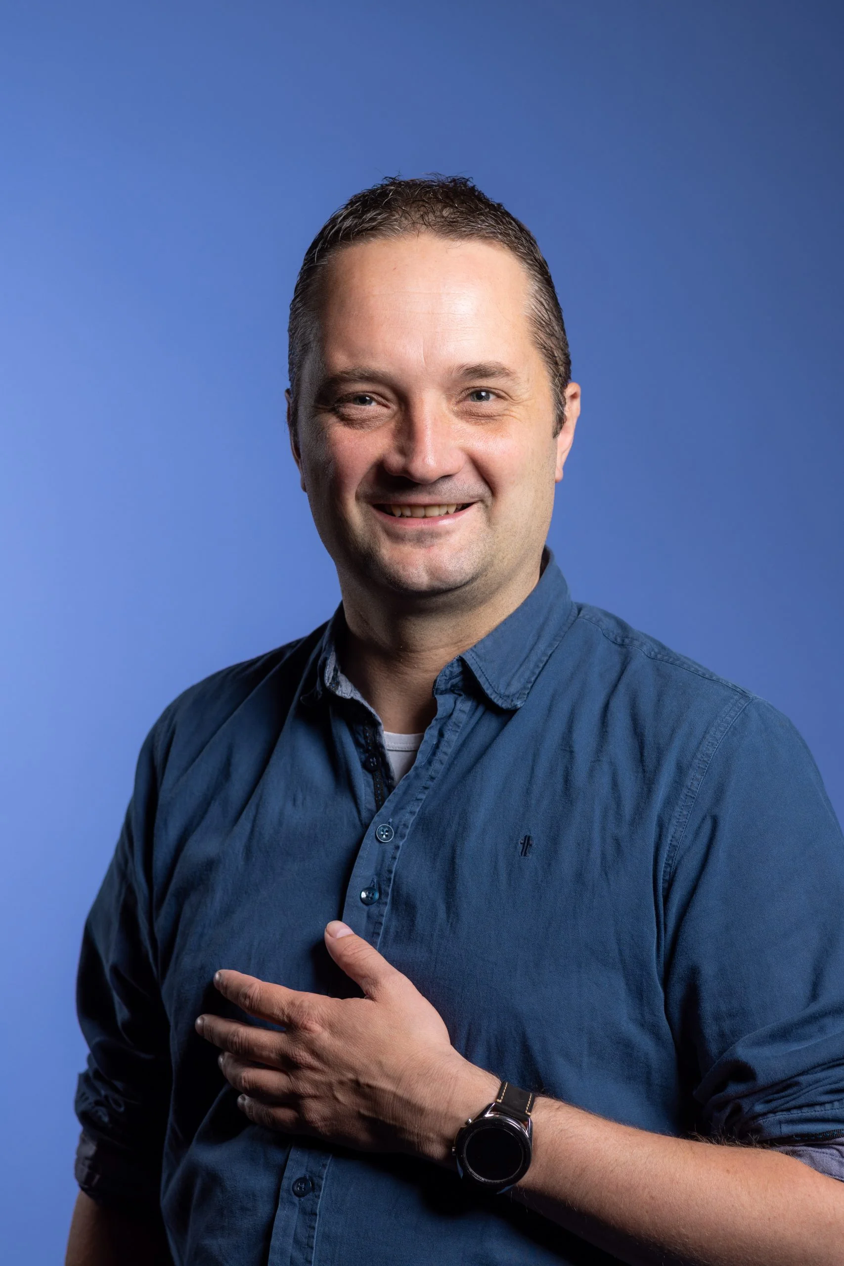
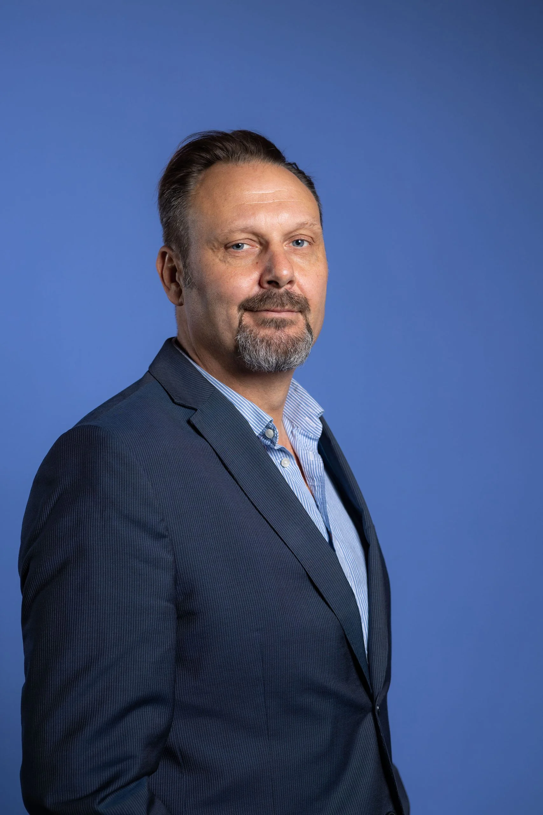
Stakeholders
Peter Hoesktra (strategic advisor)
Luuk Admiraal (Q-ICT)
Pierre Kleine Schaars (QaaS)

Slide 12

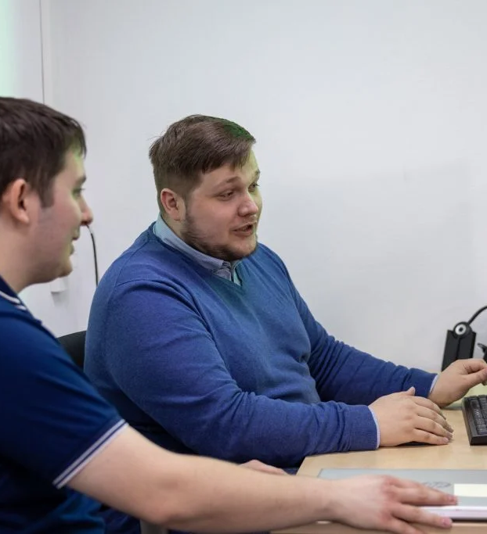
Service Desks
Offer technical assistance to customers
regarding their IT-related issues
Available time: Monday – Friday from 08:30-17:00
Indoor & outdoor customer service
Telephone, e-mail, WhatsApp, TeamViewer

Slide 13
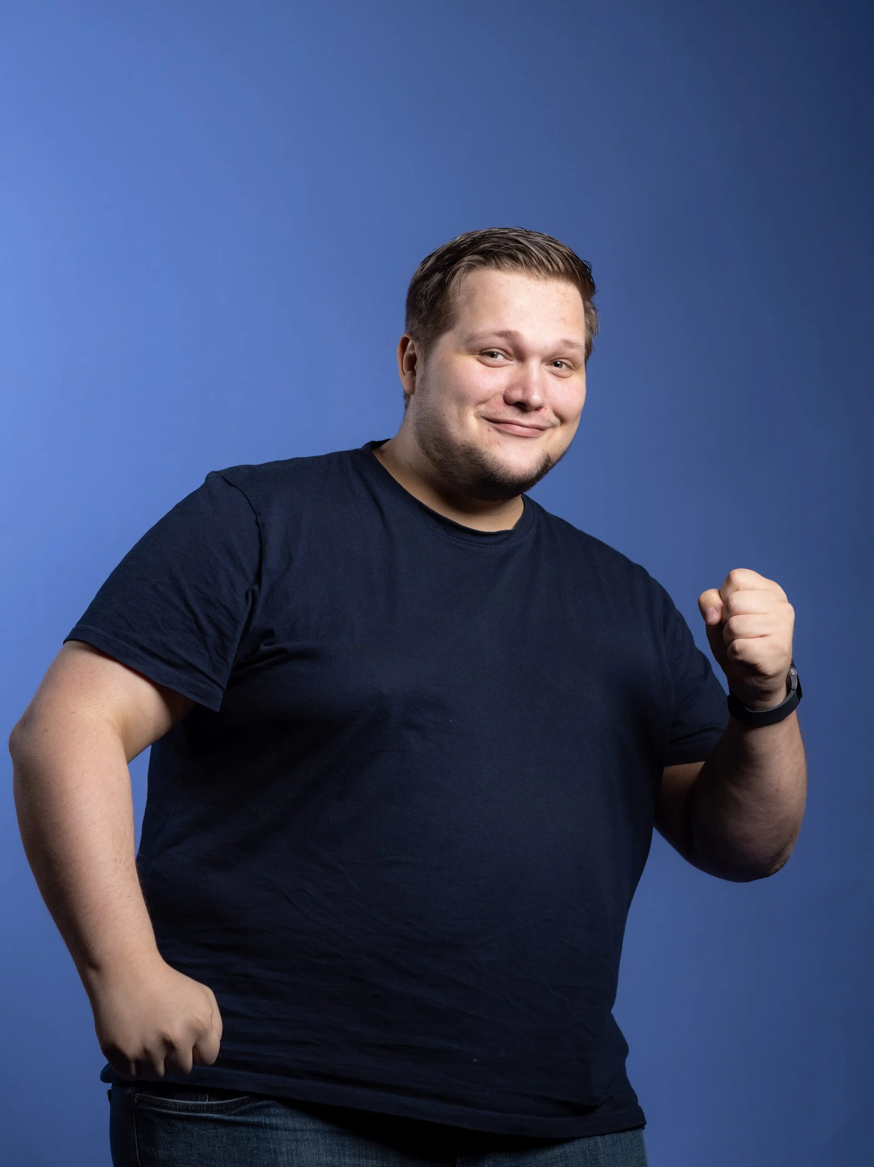
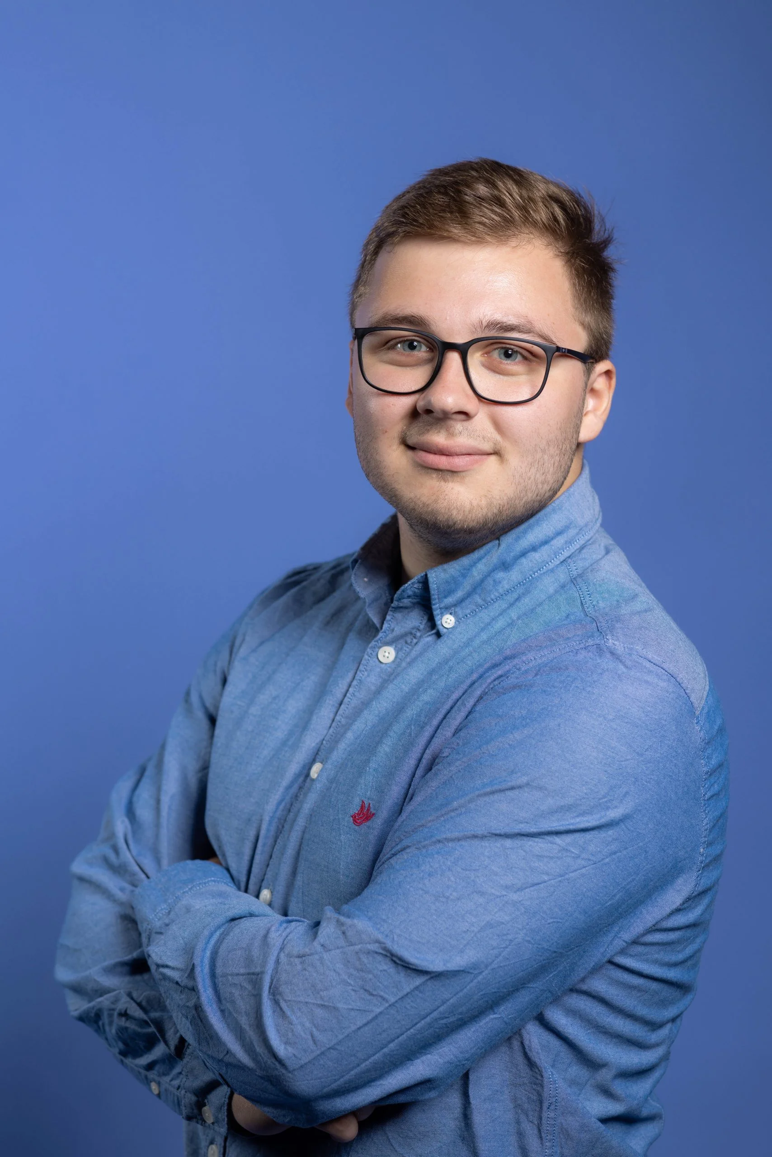
First Call Helpdesk
Bram Regtop (team leader)
Dax Moorman & Wesley Keizer (system engineer)

Slide 14
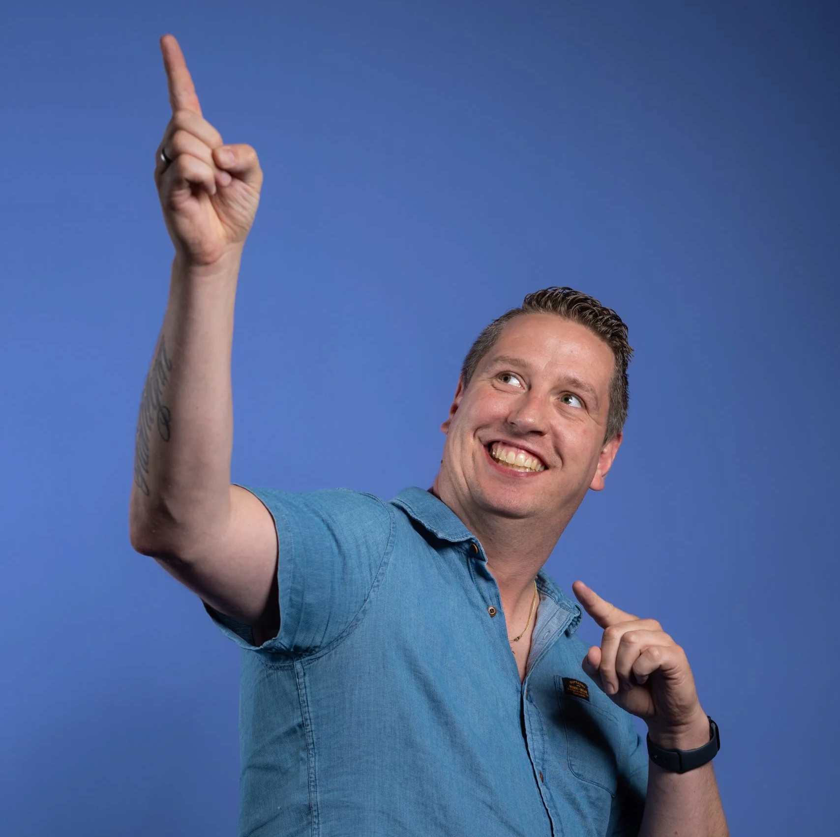
Second Call Helpdesk
Anthony Fictorie (Senior System Engineer)

Slide 15


Cybersecurity Specialist
Robert Remie
Performs cybersecurity scans, pen-tests, active monitoring, etc.,
Responsible for supervising interns that specialize in computer networks

Slide 16
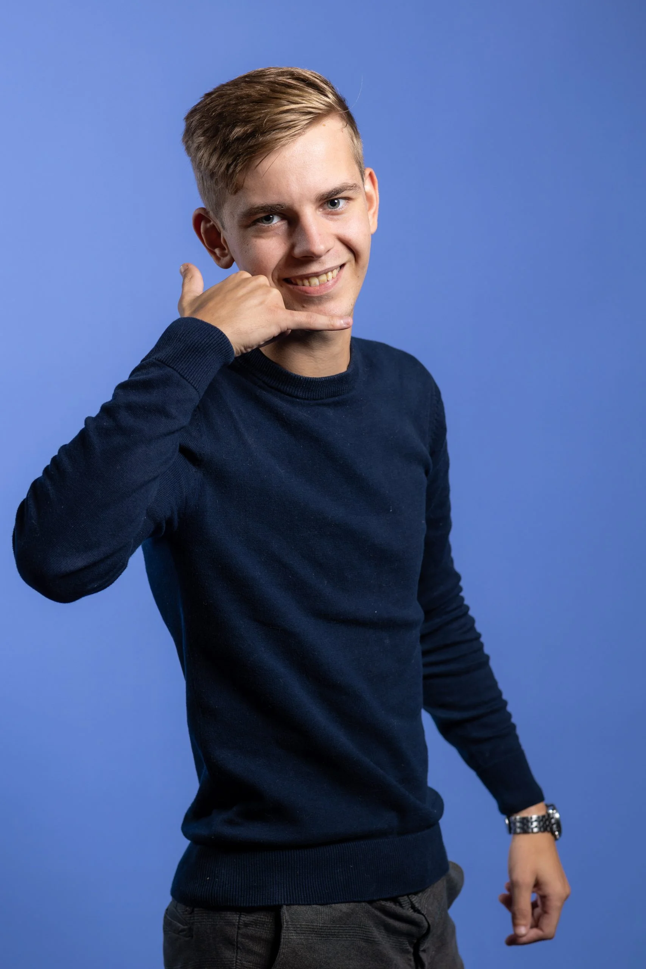
Financial Administrator and Accountant
Job Kremer (Account Manager)
Marieke Bouwers (Accountant)

Slide 17
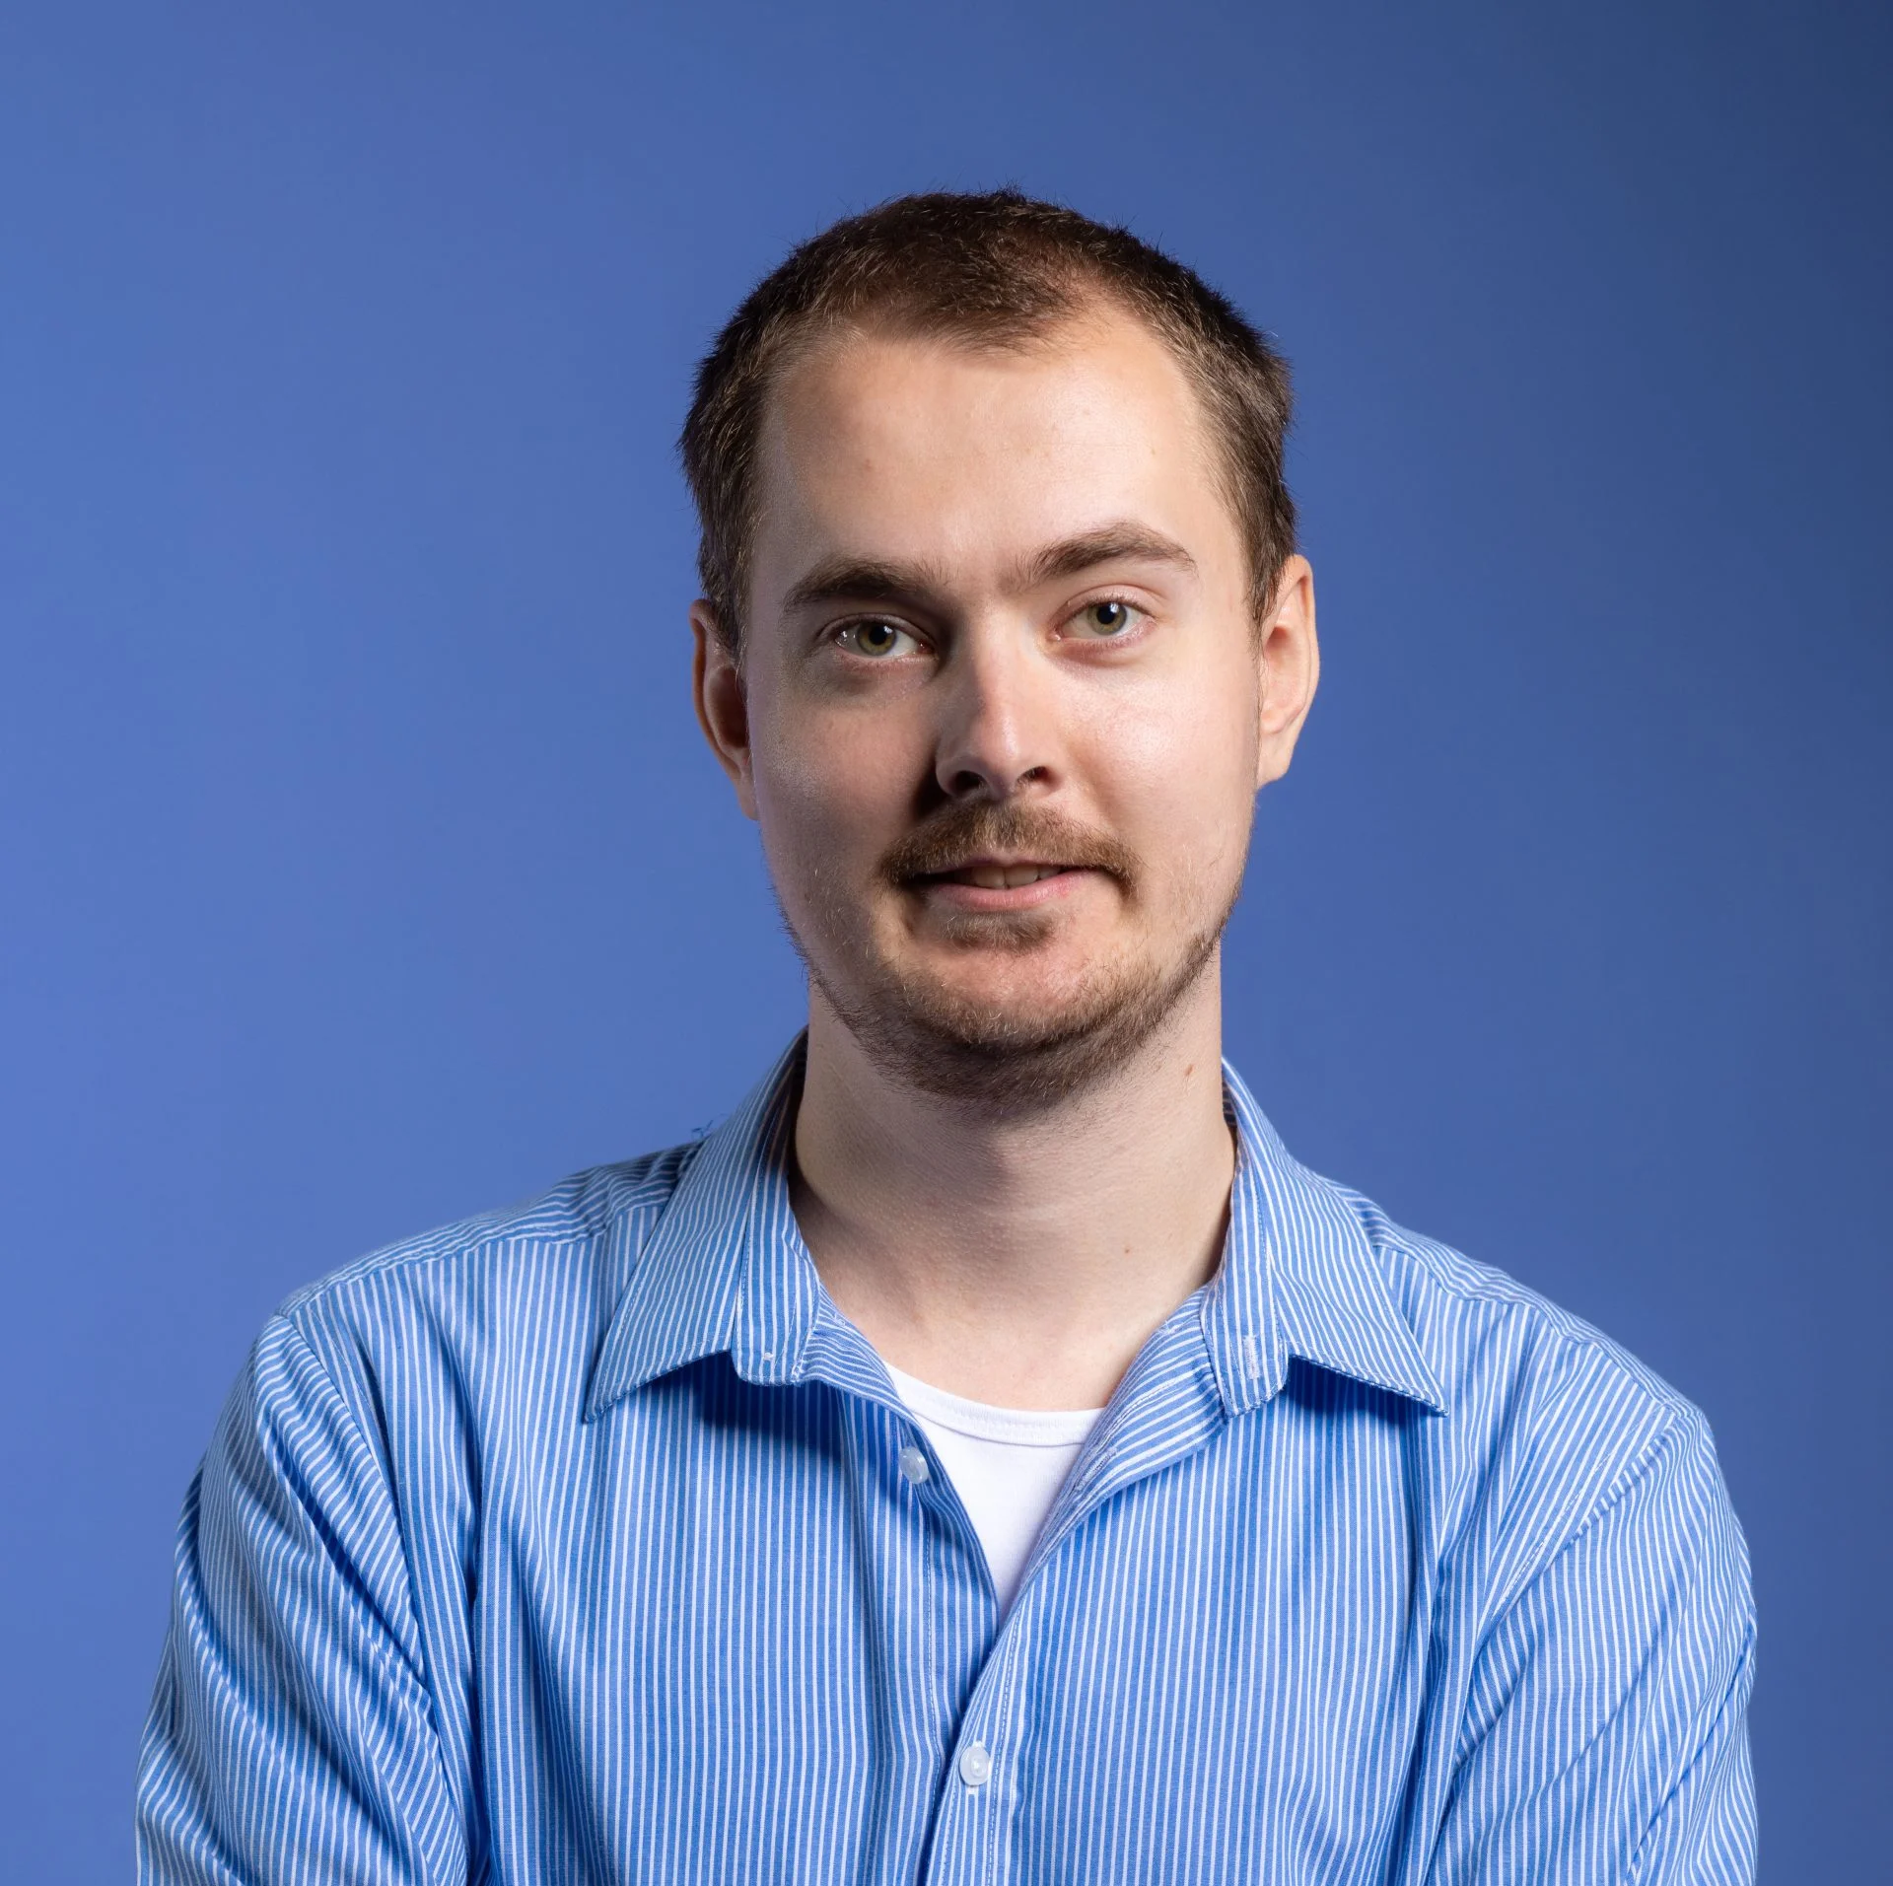
Software Developers
Manuel Weidijk (senior software developer)
Responsible for supervising the interns that specializes in software developments

Slide 18
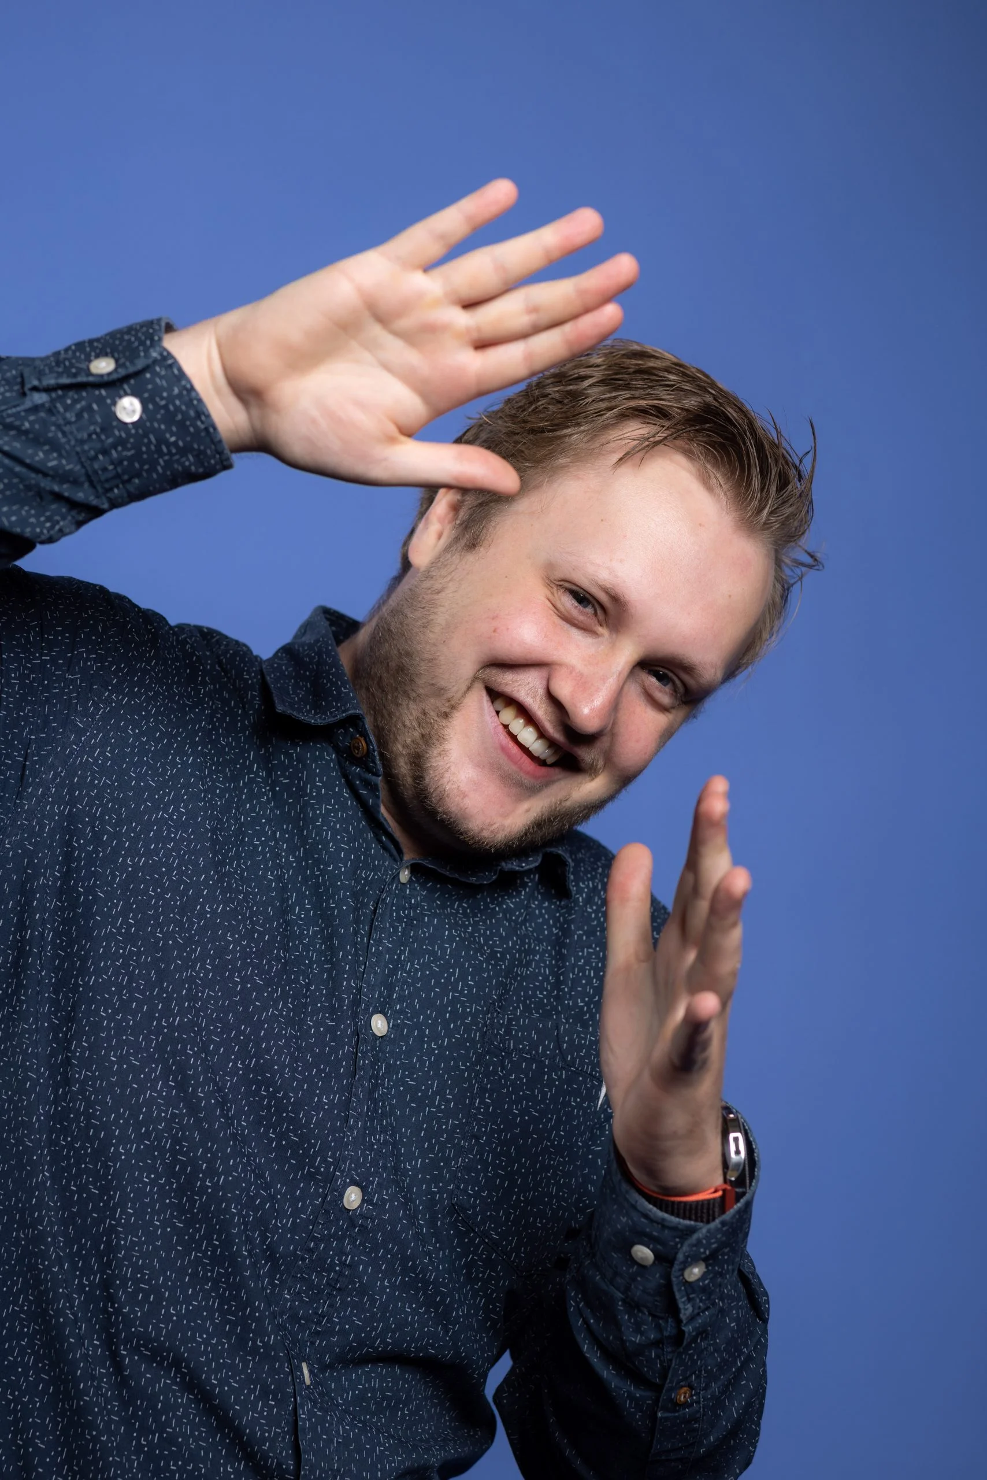
Interns
Robin Kolk
Jeroen Wind
Batuhan Gezgin
Sybren Hijmans
Andre van Vliet
Isaac Semackor
Christopher Sulistiyo

Slide 19
Work Placement
Start date: 4 September 2023
End date: 15 January 2023
Vacation days: 10 days
Supervisor: Manuel Weidijk, lecturer: Rene Laan
Working days: Monday-Friday 08:30-17:00 with 30 minutes break
Front-end & back-end
Agile SCRUM methodology: daily stand-ups, sprint review, SCRUM board

Slide 20



Work Placement Project
A template for ERP-application like project
Front-end Programming language: Dart
Back-end:
Framework: Flutter
Azure
Azure DevOps
Database: AzureSQL
IAM: AzureAD
Platform(s): web and mobile (Android)
Visual Studio Code & Android Studio

Slide 21
What I’ve Done So Far
Initial documents for the work placement lecturer (PDP, Planning)
Made a research topic
Research about comparison between Azure and GCP (Google Cloud Platform)
Work Placement Report (company research and research topic)
Software Design document (description, mock-ups, ERD, Class Diagram, design patterns, architectural patterns, JSON schema)
Made presentation and video for the Return Day

Slide 22
What I’m Currently Doing
Realization phase
Realize database and external API
Proof of Concept
Learning and researching about Flutter
Notes:
Realizing a way to import third-party API, page route management, two-step authentication

Slide 23
What I’ll Doing in the Future
Programming
Unit Test
Responsive design optimization for mobile

Slide 24
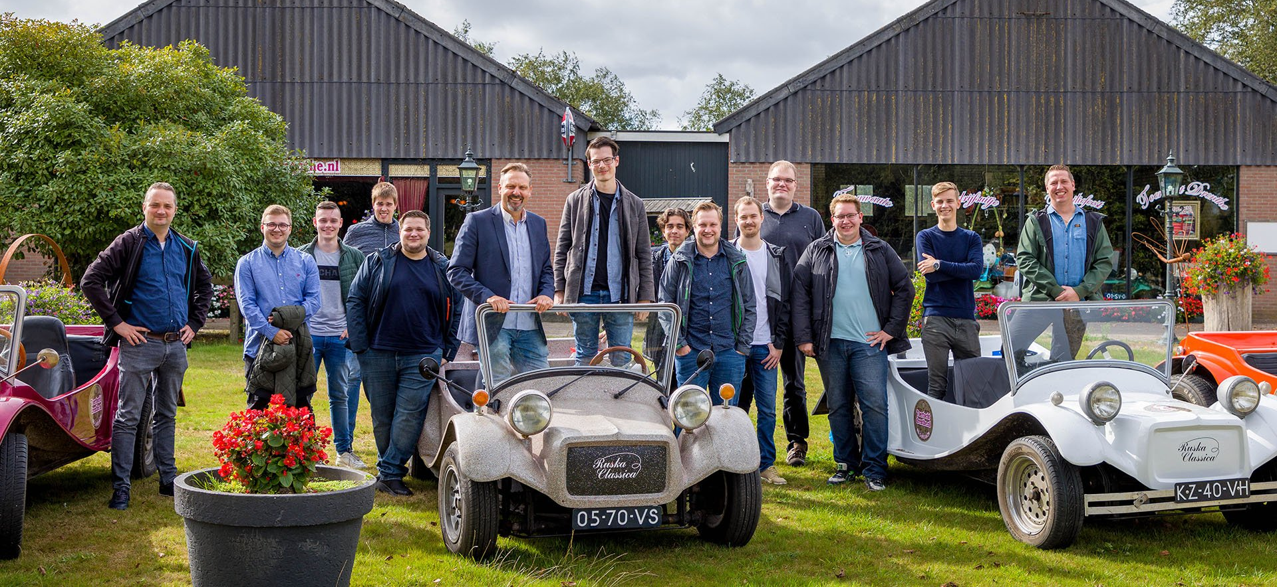
Thank you for your attention!
Do you have any questions?

